Slide 1
The Role of a Paralegal in a Commercial Real Estate Deal
Presented by
Mariana Fradman,
Senior Legal Assistant Chadbourne &Parke LLP

Slide 2
The Life of a Real Estate Deal

Slide 3
The Life of a Real Estate Deal
Due Diligence
Negotiation
Pre-Closing
Closing
Post-Closing Activities

Slide 4
Where do paralegals fit?
Due Diligence
Pre-Closing
Closing
Post-Closing

Slide 5
Where do paralegals fit?

Slide 6
Where do paralegals fit?
Negotiation process…is a process…

Slide 7
Due Diligence
What is Due Diligence?
Survey
Title
Leases, licenses and agreements
Corporate documents
Various liens and litigations, etc.

Slide 8
More on Due Diligence
Where do we start?

Slide 9
More on Due Diligence (cont’d)
What Side of the Pond You Are?
Buyer
Seller
Lender
Others

Slide 10
More on Due Diligence - Checklist

Slide 11
More on Due Diligence (cont’d)
Data Room and Share Drive
Where they are?
Why share?
How to share?
What to share?

Slide 12
More on Due Diligence (cont’d)

Slide 13
More on Due Diligence (cont’d)
Order searches (tax and lien searches, open litigations, UCC searches, etc.)
Where do you go?
Order Title Report
Order Survey
Order Zoning Report

Slide 14
More on Due Diligence (cont’d)
Keep a horse in front of a wagon (the role of a closing checklist)
Keep the team updated on incoming results

Slide 15
More on Due Diligence (cont’d)
Regular updates on a checklist
Did I say daily?
Or hourly?
Conference Calls and your role

Slide 16
More on Due Diligence (cont'd)
Organizational Chart

Slide 17
More on Due Diligence (cont'd)
Organizational Chart
Certificate of Formation/Articles of Incorporation, etc.
Is the Company in Good Standing?
Where does the Company do business?

Slide 18
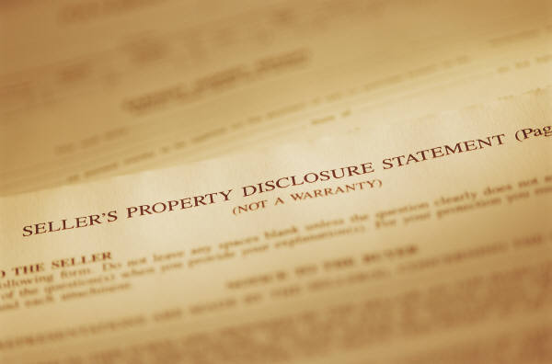
More on Due Diligence (cont'd)
Do we need consents and waivers and how to get them?

Slide 19
More on Due Diligence (cont'd)
Third Parties
Landlords
Tenants
Insurance Carriers
Assignments
The "old" and the "new" (the story about lenders)
The Regulatory Labyrinth

Slide 20
More on Due Diligence (cont'd)
Here they come: Estoppels and SNDAs
How to keep all parties on the same page
Time Frames
Can you rely on third parties - your deliveries dates

Slide 21
Manage your team players
Yes, you hear me right - a paralegal can manage a team by…
Keeping a checklist up to date
Delivering results in a timely matter
Delivering bad news as soon as you hear them
Preparing a game plan on how to resolve the obstacles
Manage Egos and Personalities

Slide 22
Manage your team players (cont'd)
Give them results
Don't overburden team players with too much information…

Slide 23
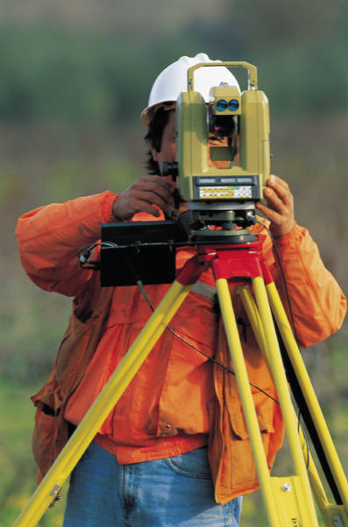
Some More on Due Diligence - when you have questions:
Contact surveyor and title company
Zoning Reports and how to deal with them
Environmental Reports: are they my problems?

Slide 24
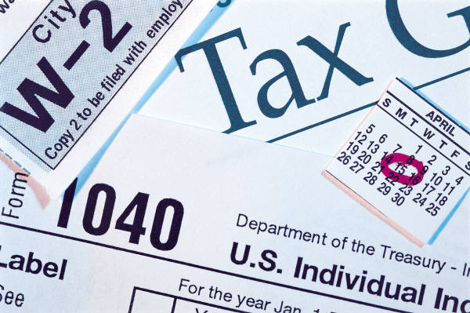
Due Diligence…again…
More on Lien Searches and their results
UCCs: Terminate or Assign?
Pending Litigations and how to deal with them
Mechanical Liens
Tax Liens: Did I hear it right: the lien was sold…

Slide 25
Pre-Closing
Organization is a key

Slide 26
Pre-Closing (cont’d)
Know who the players are
Any changes to the Organizational Chart
New Entities
3rd Parties approvals/consents
Financing and Funding issues
What did we miss? The tale of the forgotten issues
How to deal with 11th Hour Surprises

Slide 27
Pre-Closing: The tale of the forgotten issues
Domain Names
Authorizations to do business
Did you say EIN?
License Compliance
Claims that did not make the litigation list
Tax liability
Insurance

Slide 28
Pre-Closing: 11th Hour Surprises
Changes in Financial Conditions
New Litigation
Customer Complaints
Regulatory Issues

Slide 29
Pre-Closing (cont'd)

Slide 30
The Closing
Plan from the beginning
Manage the document production
Anticipate hurdles
Closing Settlement Statement: whose job is it?
Close the deal

Slide 31
The Closing
Why the closing room called a “War Room”?
Organization is a KEY
How many originals do you need?
Signatures, Notaries, Oh Mine…

Slide 32
The Closing (cont’d)
In-House Closing vs. In Escrow
Timing
Organization (again and again and again)
Distribution

Slide 33
Post Closing

Slide 34
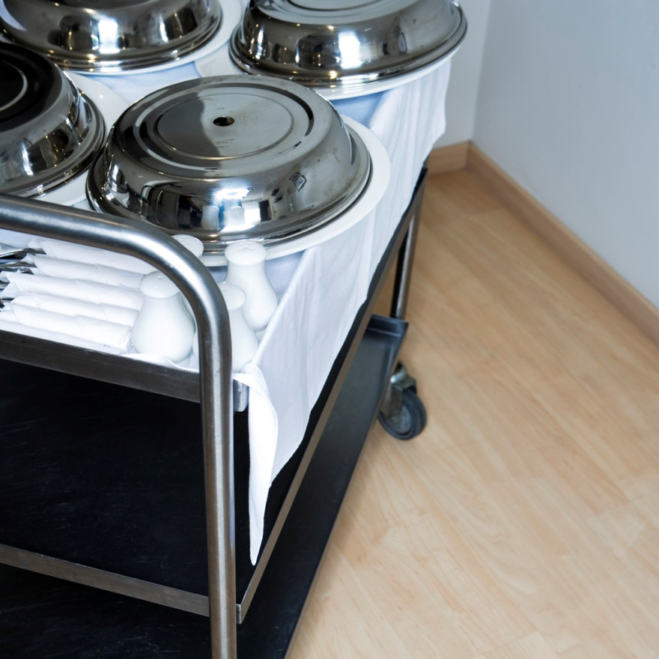
Post Closing (cont'd) – Finished? NO, We Just Started
Post Closing Deliveries
Deed
Mortgage
UCCs
Other Documents to be recorded
Non-recordable Transfer Documents

Slide 35
Post Closing (cont'd)
Notification Letter (Tenants, Suppliers)
Who is your Registered Agent?

Slide 36
More on Post Closing
Closing Binders, Closing Binders, and more on Closing Binders
Recordkeeping and Archiving of documents
Tickler System

Slide 37
Questions & Answers

